Slide 1
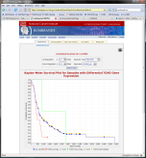
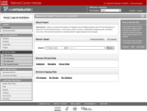
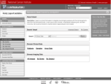
CaIntegrator2 Overview
Array Data
Project Team
Public
Software Development Team
Project Team
Clinical Data
Rembrandt (for example)
Imaging Data
caIntegrator
Process repeated again for each project, reusing code and developer expertise.
caIntegrator2
Project Team
Public
Software Development Team
View Study
caIntegrator2
Deploy Study
Study Manager
Array Data
caArray
Project Team
Clinical Data
TBD
Images
NCIA
Image Annotations
TBD

Slide 2
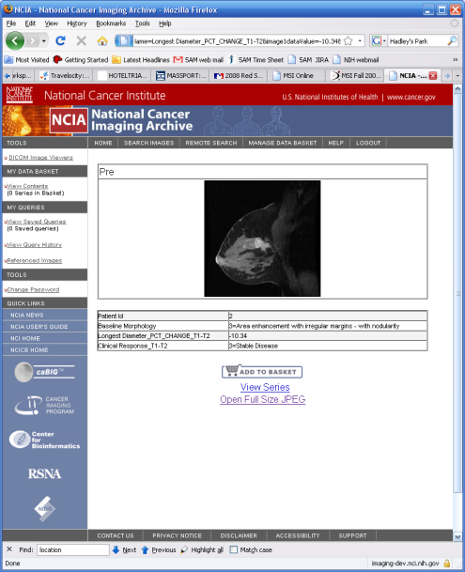
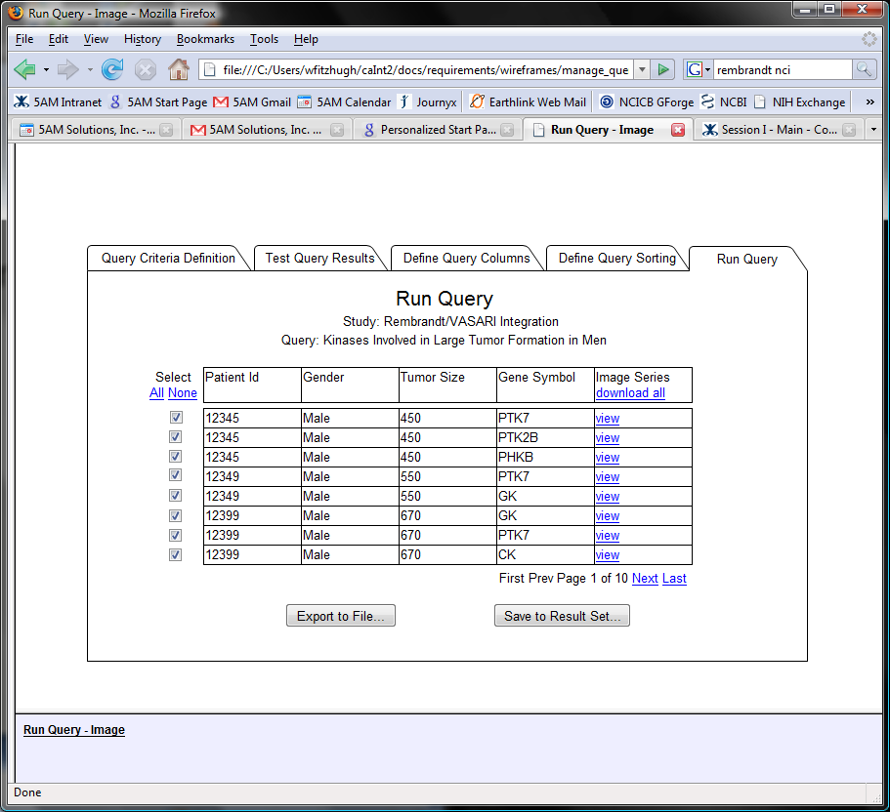
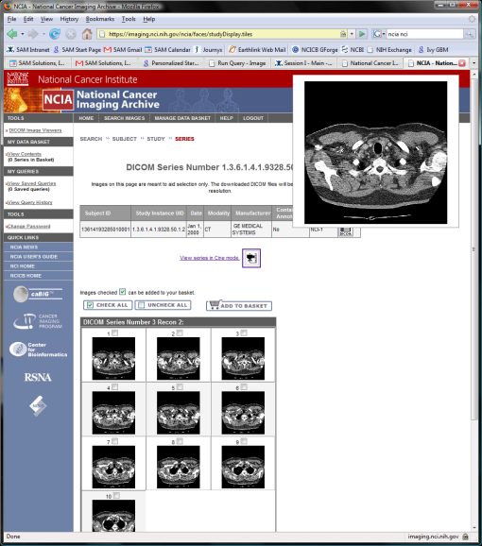
Current Plans for Image Viewing

